Slide 1
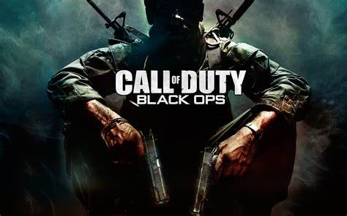
Leelynne Veverka-Cardwell

Slide 2
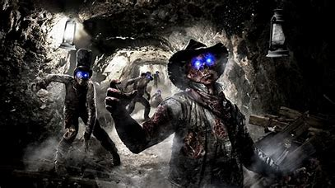
What is Call Of Duty
Call of Duty is a first-person shooter video game franchise published by Activision. Starting out in 2003, it first focused on games set in World War II. Over time, the series has seen games set in the midst of the Cold War, futuristic worlds, and outer space. The games were first developed by Infinity Ward, then also by Treyarch and Sledgehammer Games. Several spin-off and handheld games were made by other developers. The most recent title, Call of Duty: Vanguard, was released on November 5, 2021.

Slide 3
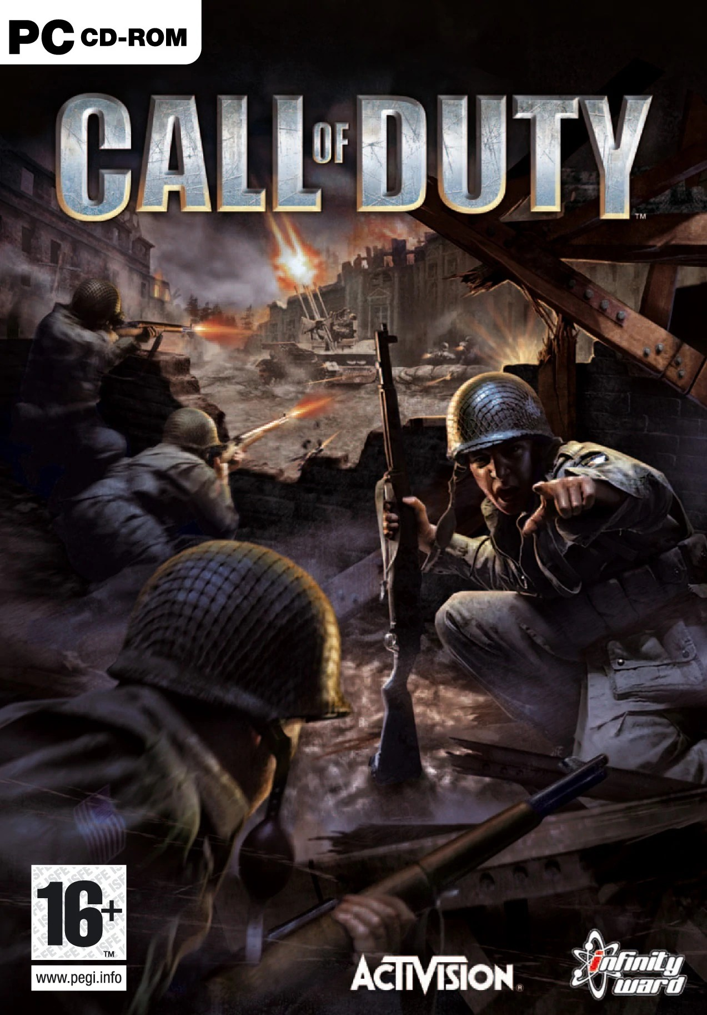
Developers
Call of Duty is a first-person shooter video game series created by Infinity Ward.
The series was published by Activision and most of the games have been developed by Infinity Ward and Treyarch, though some were developed by Amaze Entertainment and Gray Matter Interactive Studios. Newer entries have been released on a yearly basis with Infinity Ward, Sledgehammer Games, and Treyarch interchanging as producers each year.

Slide 4
Old Call Of Duty Newer Call Of Duty
Call Of Duty
Call Of Duty 2
Call Of Duty 3
Call of Duty 4: Modern Warfare
Call of Duty: World At War
Call of Duty: Modern Warfare 2
Call of Duty: Black Ops
Call of Duty: Modern Warfare 3
(2003-2011)
Call of Duty: Black Ops 2
Call of Duty: Ghosts
Call of Duty: Advanced Warfare
Call of Duty: Black Ops 3
Call of Duty: Infinite Warfare
Call of Duty: World War 2
Call of Duty: Black Ops 4
Call of Duty: Modern Warfare
(2012-....)

Slide 5
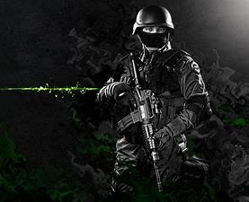
How much they sold/Images
Call of Duty List of Games: History of COD Releases (lineups.com)

Slide 6
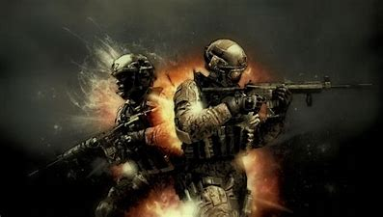
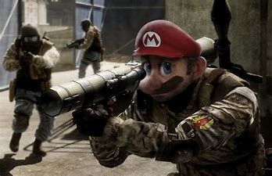
RANGE MODE!!! Beast Mode!
(841) TOP 10 CoD Modern Warfare RAGES ft. Dr.Disrespect, Faze Jev & more - YouTube
0:29
(841) Going Beast Mode In Search And Destroy | Call Of Duty Modern Warfare - YouTube

Slide 7

Call Of Duty Zombies
(841) YouAlwaysWin - YouTube
Zombie maps gives a different perspectives of playing. Making sure you know when to spend money and how to think before you waste money.
Call of Duty: Zombies (originally known as Call of Duty: World at War: Zombies and then as Call of Duty: ZOMBIES) is a spin-off game of the Call of Duty series based on the widely popular Nazi Zombies mode of Call of Duty: World at War. The game allows for multiplayer cooperative gameplay locally via a Wi-Fi or Bluetooth network, or globally through the internet. Originally, the game supported downloadable content, in the form of Verrückt and Shi No Numa. However, a future update made the two maps free.^{[1]} The game later had a sequel, Call of Duty: Black Ops Zombies.

Slide 8


Slide 9
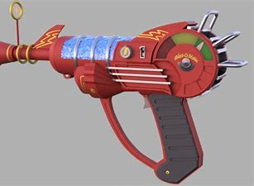
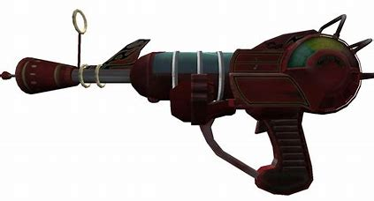
Weapons
Colt M1911 — Fast rate of fire, very low damage, average recoil, swift reload.
.357 Magnum — One shot kill up until around round 20, high recoil and damage, swift reload.
MP-40 — Decent fire rate with medium damage and recoil, swift reload.
PTRS-41 (Un-scoped) — Slow fire rate with extremely high damage and low recoil, slow reload.
Gewehr 43 — Decent fire rate with medium damage and low recoil, average reload.
Browning M1919 — High fire rate with high damage and little recoil, very slow reload and very large ammunition capacity.
M1897 Trench Gun — Very slow rate of fire, very high damage with little recoil, pump-action, slow reload.

Slide 10
Weapons part 2
Arisaka — Slow bolt cycling, low damage, average recoil and reload speed. Only available in Shi No Numa. Very similar to the Kar98k.
Knife — Kills zombies in the number of rounds passed divided by two on Regular difficulty. One hit kill up to round 5 on Recruit difficulty.
Type 100 — Average RoF, medium damage, very low recoil and very fast reload.
Wunderwaffe DG-2 — Infinite damage, can kill up to 10 zombies with one bolt; minor splash damage; magazine of three. Only available in Shi No Numa and Der Riese.
Shovel — A melee weapon unique to Shi No Numa that is acquired after all the doors on the map are opened.
M1 Garand — Medium RoF, high damage, little recoil, average reload speed. Unlike the console version, the Rifle Grenades attachment is not available.
Kar98k — Slow bolt cycling, low damage, average recoil and reload speed.
M1 Carbine — Fast RoF, decent damage, low recoil and average reload speed.
Thompson — High rate of fire, high recoil, high damage, and very fast reload.
Double-barreled shotgun (sawed off and non-sawed off) — High rate of fire, extremely high damage, high recoil and slow reload.
FG-42 — Very high fire rate, high damage, average recoil and reload speed.
BAR — Low rate of fire, high damage, average recoil and reload speed.
PPSh-41 — Very high rate of fire and medium damage, killing with a single headshot until around round 16, average reload.
STG-44 — Decent rate of fire with medium damage and negligible recoil, slow reload.
M2 Flamethrower — No recoil at all, continuous high flame damage; requires cool down after use. No aiming reticle at all. Also available in the Sniper Cabinet for 2000 points in Nacht der Untoten.
Ray Gun — Very high damage, low recoil, and slow traveling laser beams. No splash damage, average reload.
Springfield — Slow bolt cycling, medium damage, medium recoil, average reload. Only available in Nacht der Untoten and Verrückt.
MG42 — Very high RoF, high damage, moderate recoil, average reload and very large ammunition capacity.

Slide 11
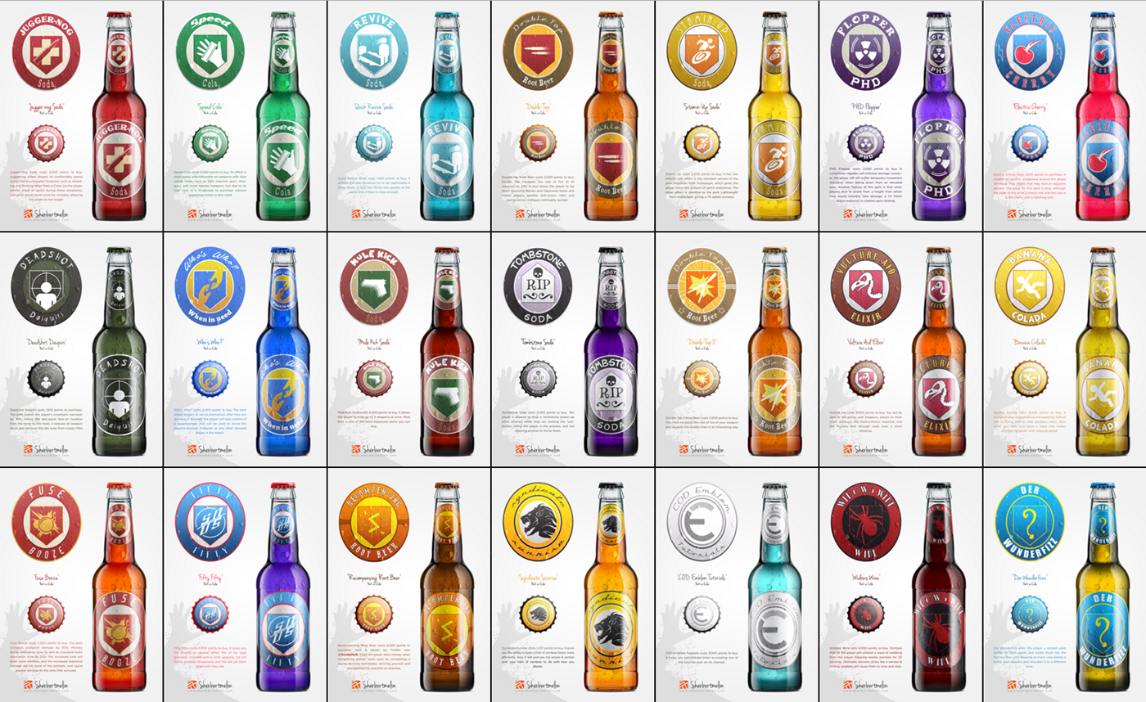

Slide 12

Perks
Call of Duty: Mobile Multiplayer Perk List | Guides (zilliongamer.com)
THERE'S A LOT OF PERKS!!! I DIDN'T KNOW MUCH OF THESE EXISTS!!!

Slide 13

Citations
New Call of Duty: Modern Warfare Delivers Fresh Multiplayer Modes (dailydot.com)
Call of Duty: Mobile Multiplayer Perk List | Guides (zilliongamer.com)
Call of Duty - Wikipedia
A Visual History of Call of Duty - IGN
Call of Duty List of Games: History of COD Releases (lineups.com)
Perks in call of duty zombies - Bing images
Call of Duty: Zombies | Call of Duty Wiki | Fandom
(841) TOP 10 CoD Modern Warfare RAGES ft. Dr.Disrespect, Faze Jev & more - YouTube
(841) Going Beast Mode In Search And Destroy | Call Of Duty Modern Warfare - YouTube
(841) YouAlwaysWin - YouTube

